Slide 1
Top video lectures that any developer should see
Yoav rubin
@yoavrubin

Slide 2

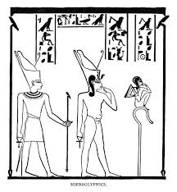


Slide 3


